Slide 1
Birdsongs
in
Random
FORESTS
FORESTS
Extremely Randomized Trees classifier using
crowdsourced birdsongs

Slide 2
Xeno-Canto
Xeno-canto.org is a website dedicated to bird sounds
Researchers, bird watchers, people curious about bird sounds upload
A collaborative project, a massive archive (0.5 million sounds+)

Slide 3
Preprocessing
FFT
spectrum
power
freq

Slide 4
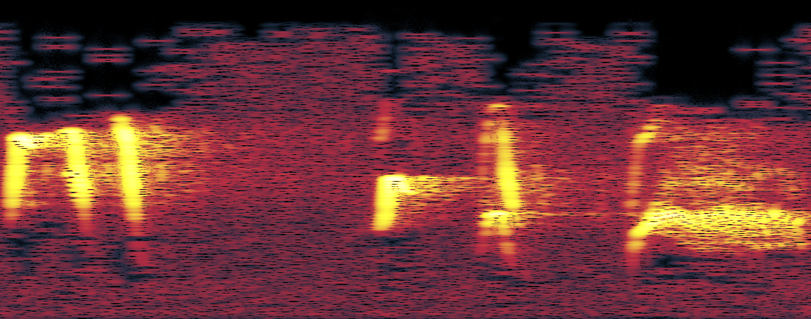
Spectrogram
freq
time

Slide 5
Spectrogram
freq
time

Slide 6
Spectrogram
freq
time

Slide 7
Spectrogram
freq
time

Slide 8
Spectrogram
freq
time

Slide 9
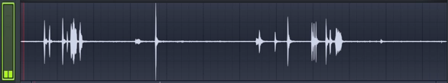
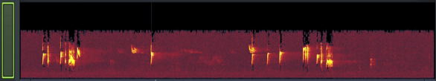
XC7641 - Blue-grey Gnatcatcher - Polioptila caerulea.mp3

Slide 10
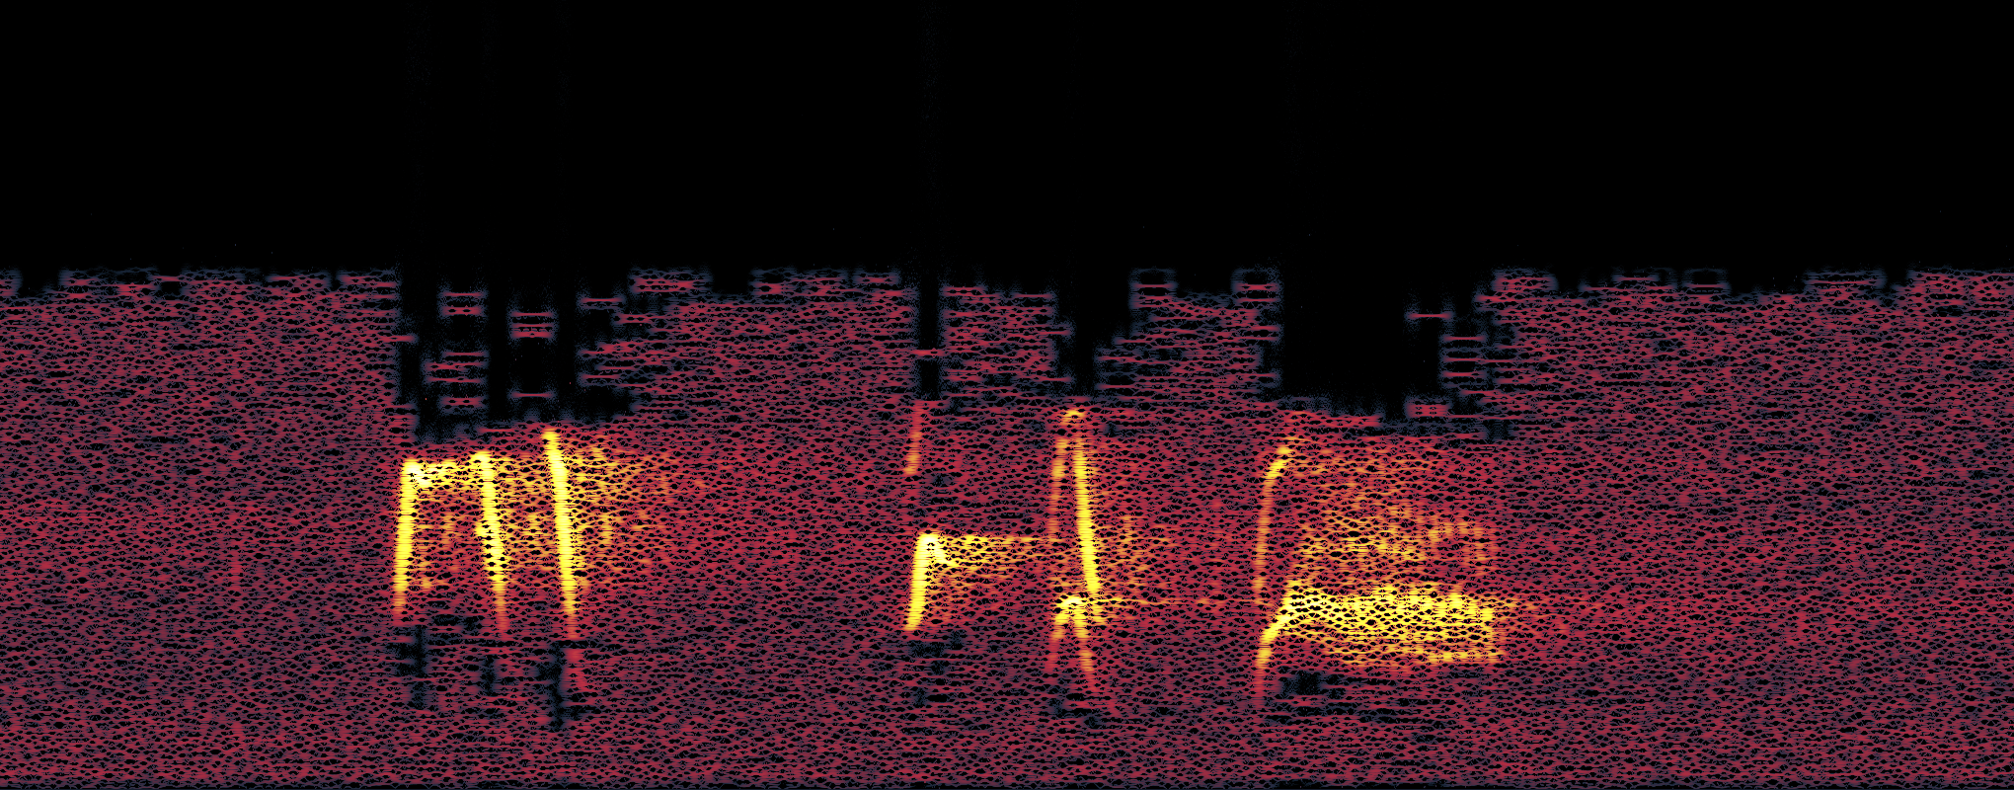
Signal/Noise
power
freq

Slide 11
Signal/Noise

Slide 12
Signal/Noise
(0.12 3.69 5.44 3.79 ... 0.30) ∈ ℝ²⁷
f
f
----
mean
Q25
Q75
----
dom
fund
t
----
mean
Q25
Q75
----
skew
kurt
info
----
entropy
23,000
...
t

Slide 13
Workflow + Pitfalls
Making / Testing Classifiers
Downloading audio
Preprocessing
Extracting features
Not drinking coffee

Slide 14
Workflow + Pitfalls
0.5 million
Country
Type:{song|call|
wing flaps|…}
Quality:{A|B|C|D|E}
~8k labelled
23,000 FV
22k labelled
50k labelled

Slide 15
Workflow + Pitfalls
3
Overworked
Laptops
1
Super
Supercomputer

Slide 16
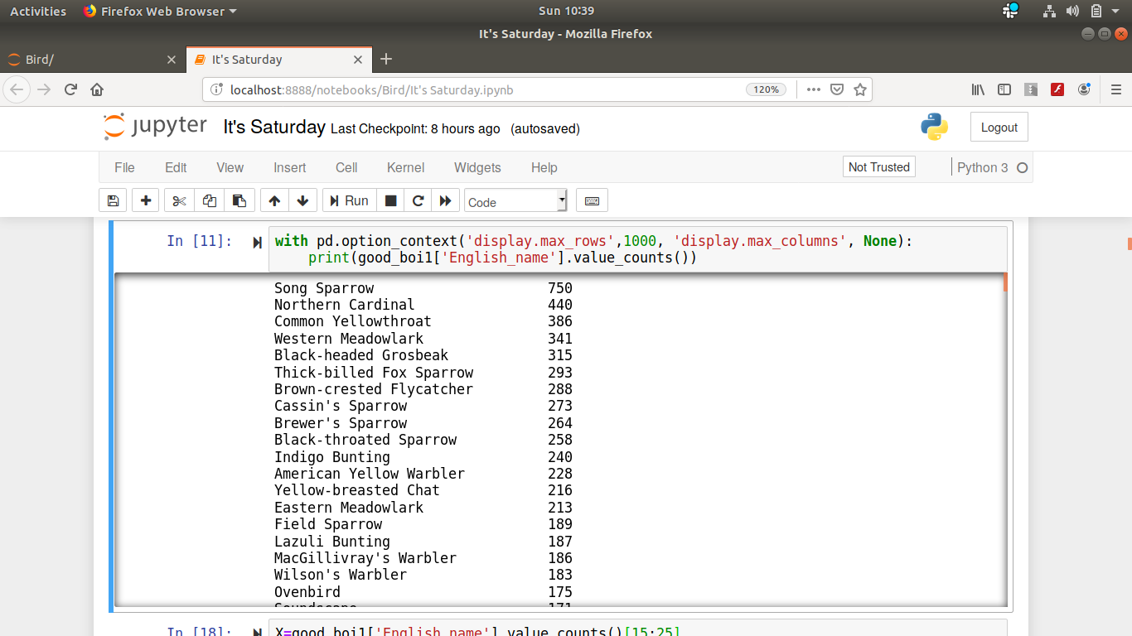
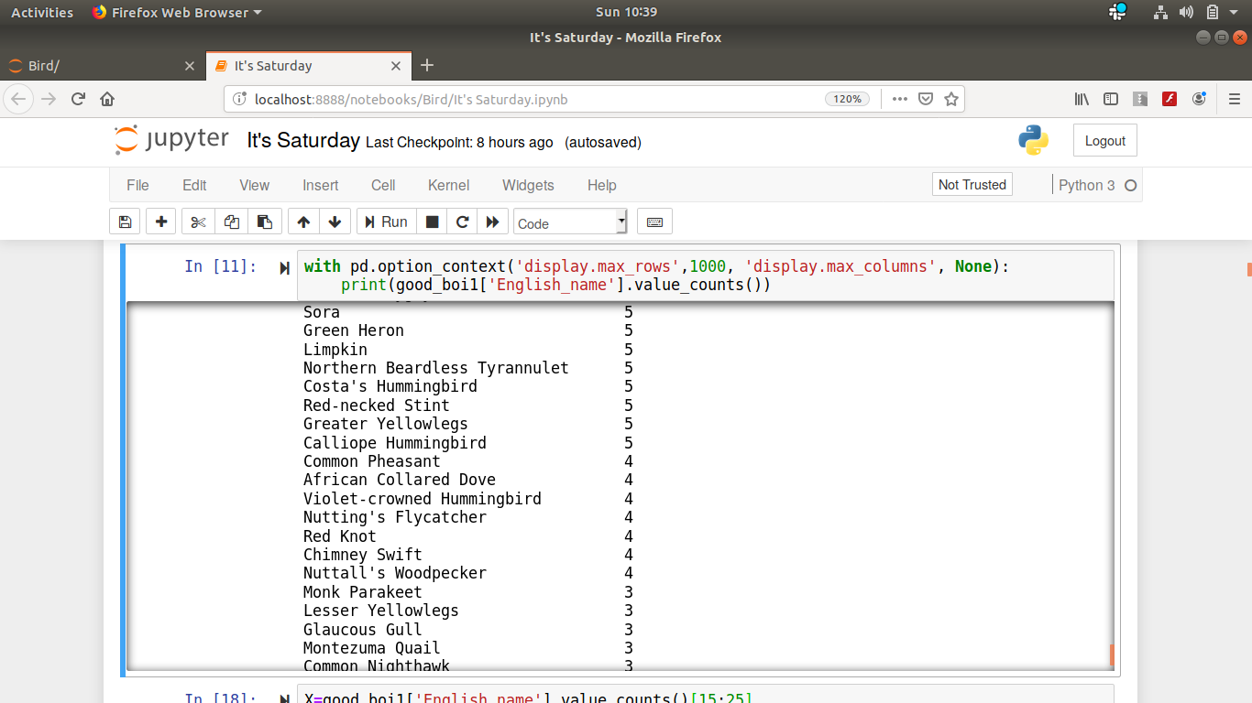
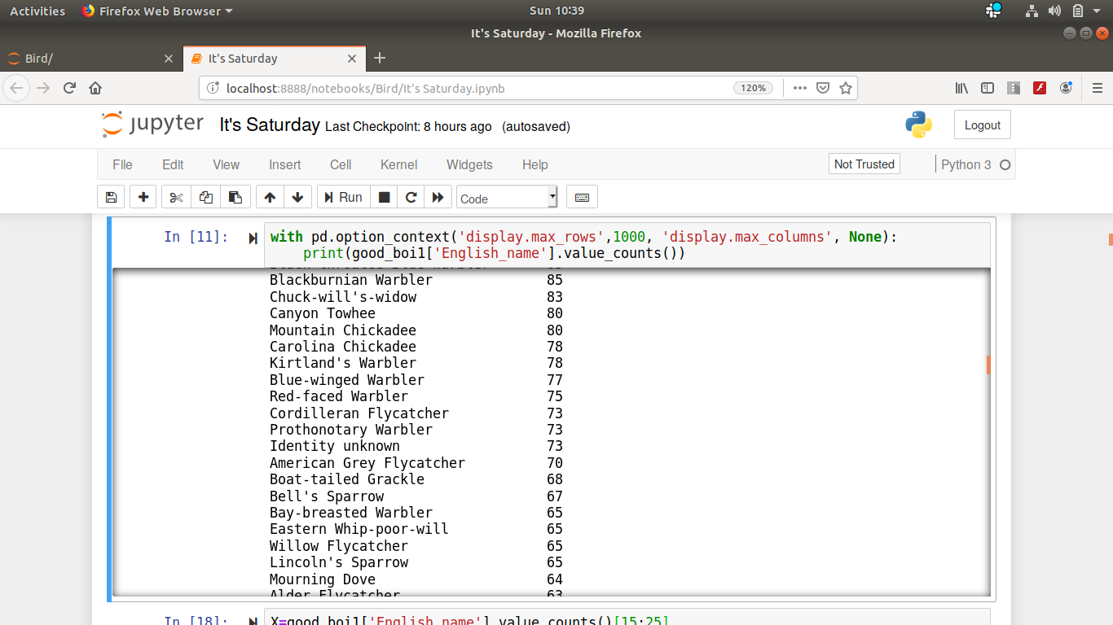
Cleaning up data
Naively, we put everything we got into a classifier…
Took a closer look

Slide 17
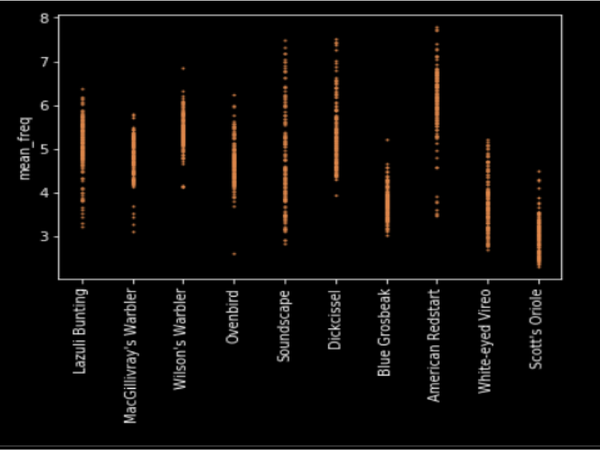
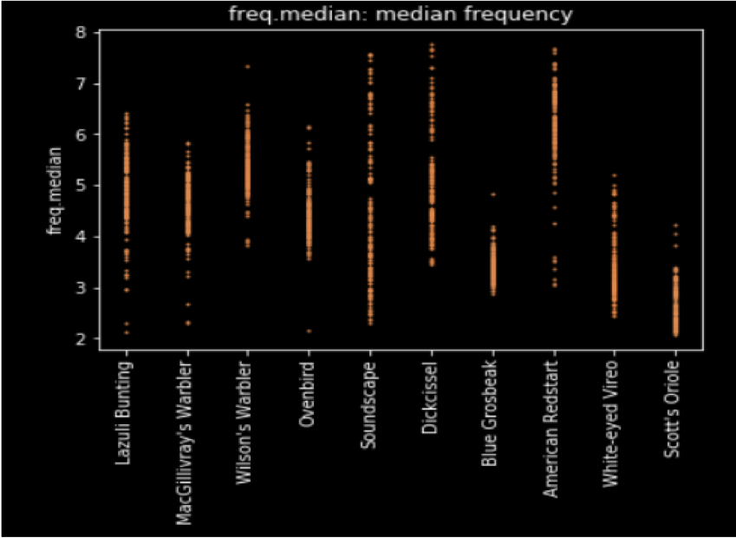
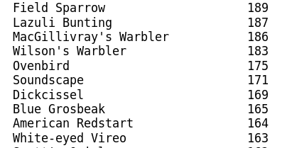

Slide 18
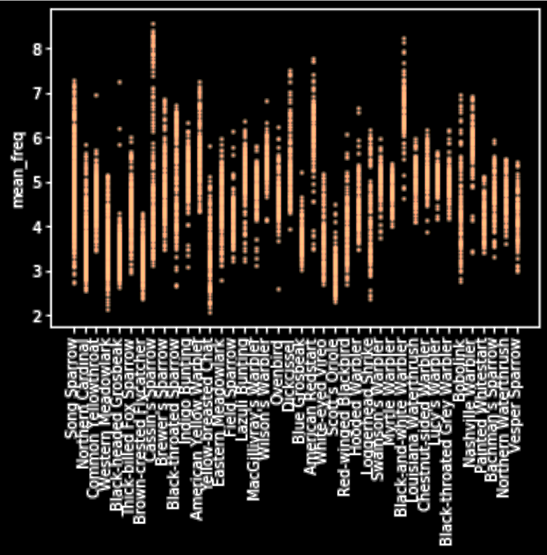
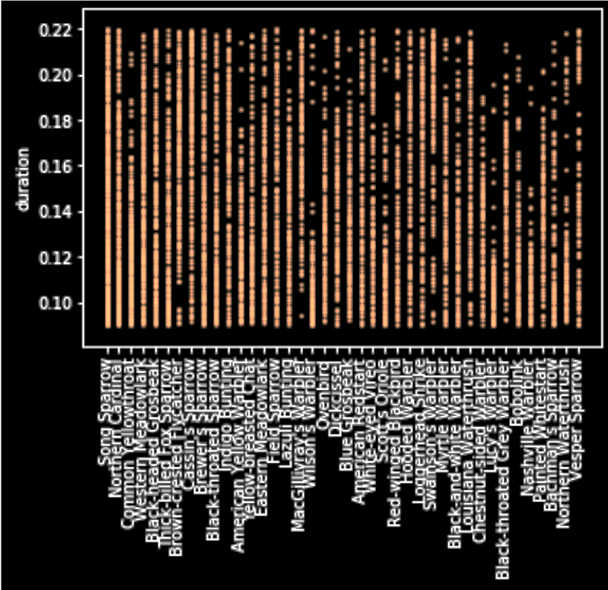
Excluded Features

Slide 19
Workflow + Pitfalls
“Mystery”
“soundscape”
NA NaN
“Sonus
naturalis”
~20k
FEATURE VECTORS

Slide 20
Workflow + Pitfalls
R
Py
Py
Preprocessing : tuneR, warbleR
Feature ext : warbleR
Cleaning, handling data : pandas
ML : sklearn
Visualization : matplotlib

Slide 21
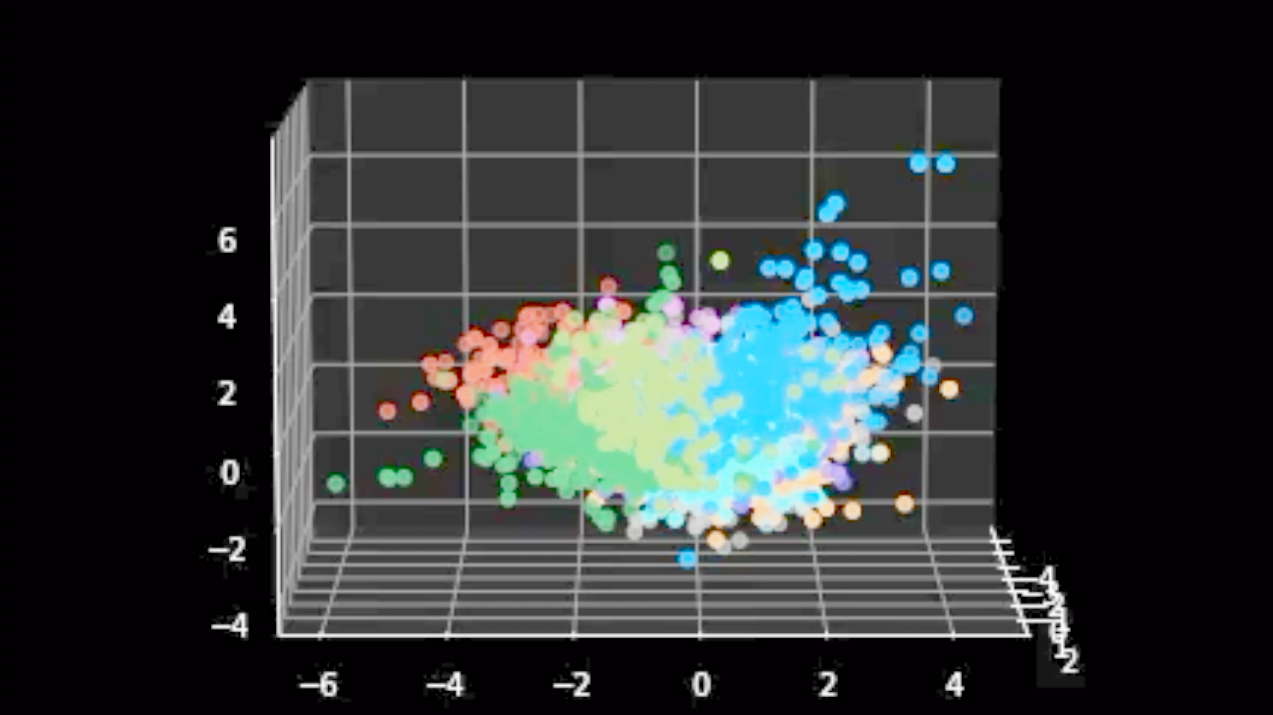
Result

Slide 22
Result
Many coffees later…
84%
Birdsongs on
Extremely Random Trees

Slide 23
Result
?
Birdsongs on
Extremely Random Trees

Slide 24
Decision Tree | Random Forest
Select random features/samples
Train decision tree (create new splits)
Repeat many times
Take the majority vote
Adapted from https://umbrella.cisco.com/blog/2013/09/19/inside-random-forest-journey-wildlife-classification/

Slide 25
Extremely Random Trees
Select random features/samples
Train decision tree randomly
Repeat many times
Take the majority vote

Slide 26
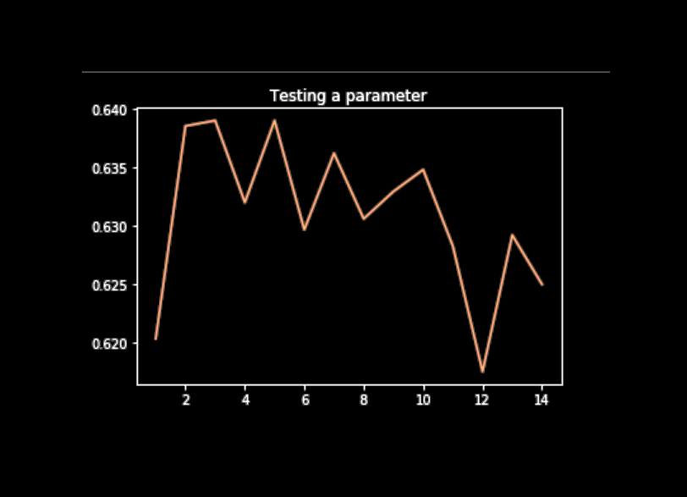
Adjusting Parameters

Slide 27
What Other Models?
Model | top 10 species | top 78 species.
Logistic Regression | 17.7% | 4.9%
SVC | 18.4% | 4.7%
LDA | 49.4% | 25.3%
K-neighbors | 60.9% | 42.1%
Decision Tree | 65.8% | 44.8%
Random Forest (RF) | 79.4% | 66.0%
RF + Adaboost | 80.6% | 65.2%
Extremely RF | 83.5% | 70.4%

